Slide 1
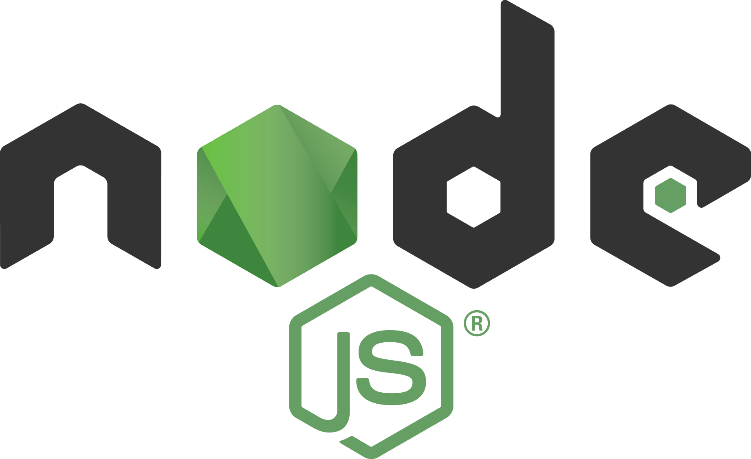
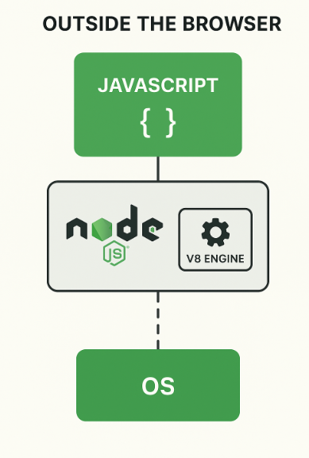
What is Node js
A runtime environment that allows you to run JavaScript code outside of a web browser mainly on the server side.

Slide 2
Outside ?
Node.js takes the same JavaScript engine (V8) used in Chrome and runs it on your computer or a server not inside a browser.
So now JavaScript can:
Read & write files on your system 🗂️
Connect to databases 💾
Handle HTTP requests & responses 🌍
Build full web servers 🚀
All these were not possible inside browsers.

Slide 3
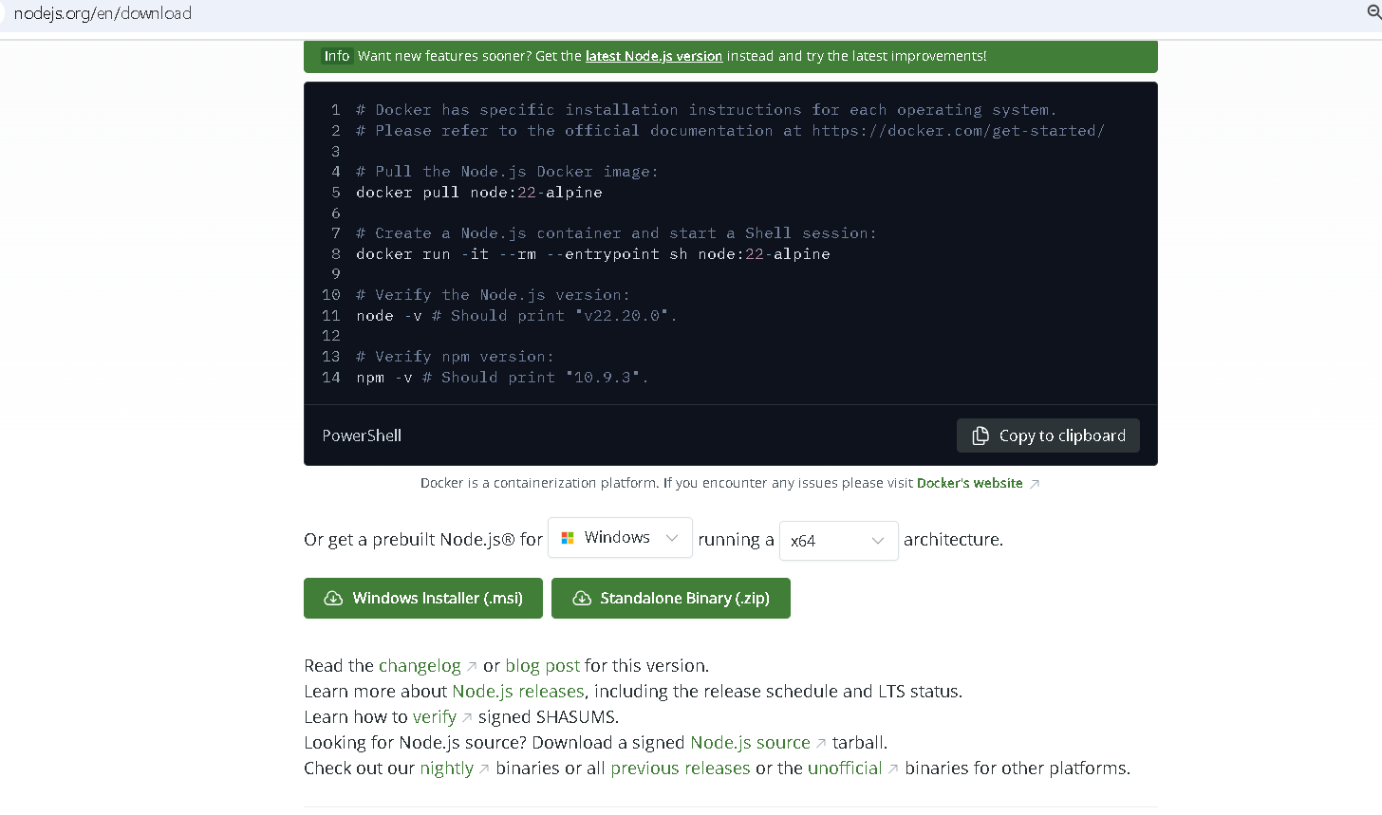
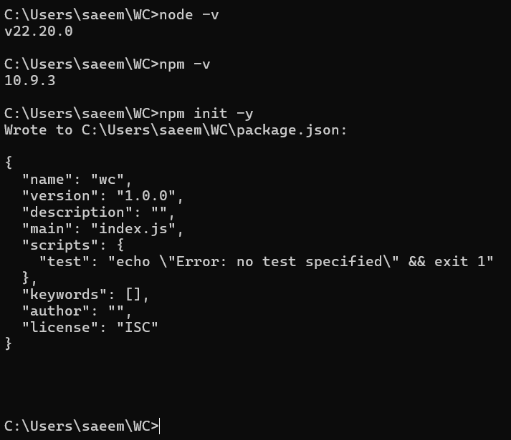
Setup & Installation?
Direct Link : Node.js

Slide 4
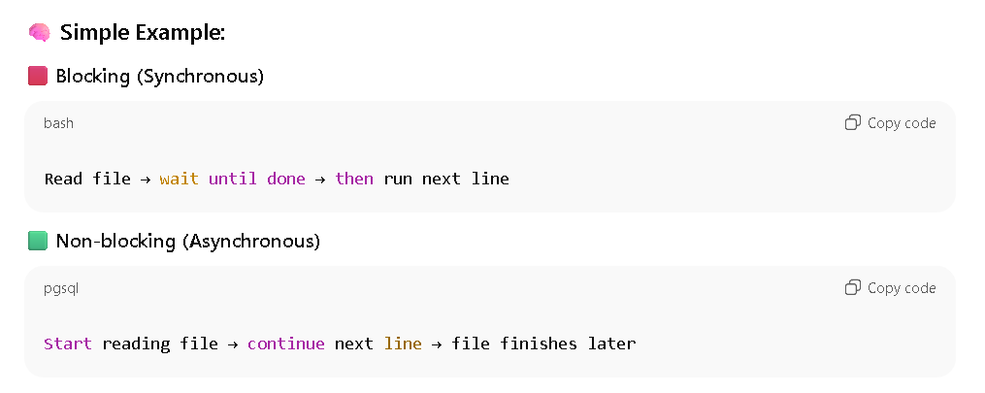
Asynchronous Programming
Asynchronous programming means executing multiple tasks at once without waiting for one task to finish before starting another.
In Node.js, this is done using
Callbacks,
Async/await

Slide 5
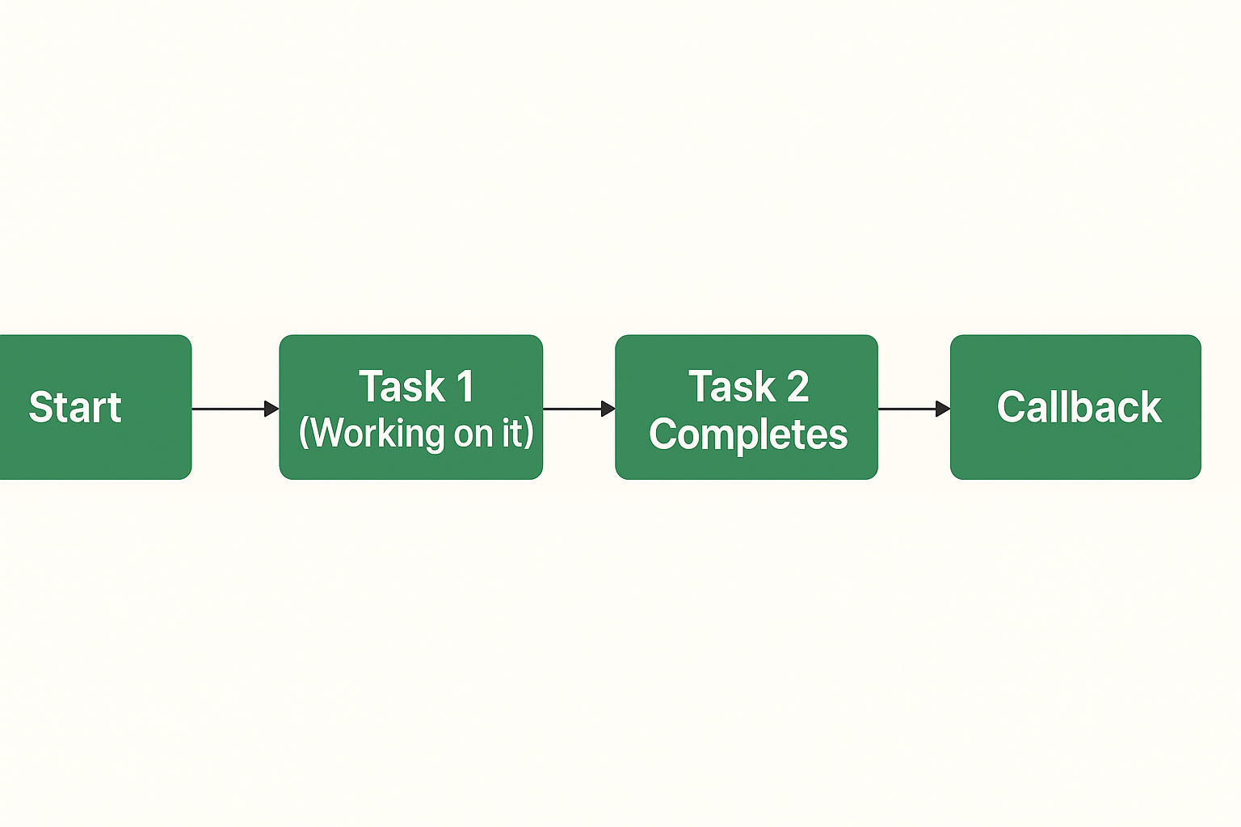
Callback Concept
What is a Callback?
A callback is a function passed as an argument to another function, which is executed later, after the first function finishes its task.
(Check for task 1 status if completed , display else run it on main thread)

Slide 6
Event Loop : Heart of Node.js
The Event Loop is the core mechanism in Node.js that allows it to perform non-blocking I/O operations even though it runs on a single thread.
⚙️ How It Works (Step-by-Step):
Node.js starts your program on a single main thread.
When it finds asynchronous tasks (like setTimeout(), fs.readFile(), etc.), it sends them to background workers.
While they’re running, the Event Loop continues executing other code.
When a background task finishes, its callback is pushed into the Event Queue.
The Event Loop picks it up and runs it when the main thread is free.

Slide 7
Code Implementation

Slide 8
Thank you !!!
Any Doubts ???

